Slide 1


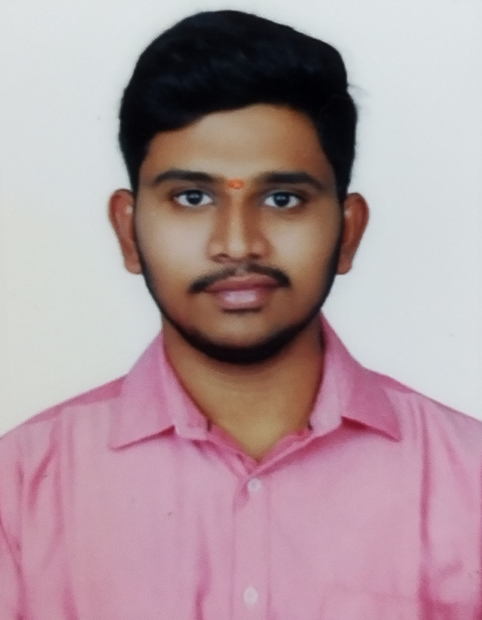
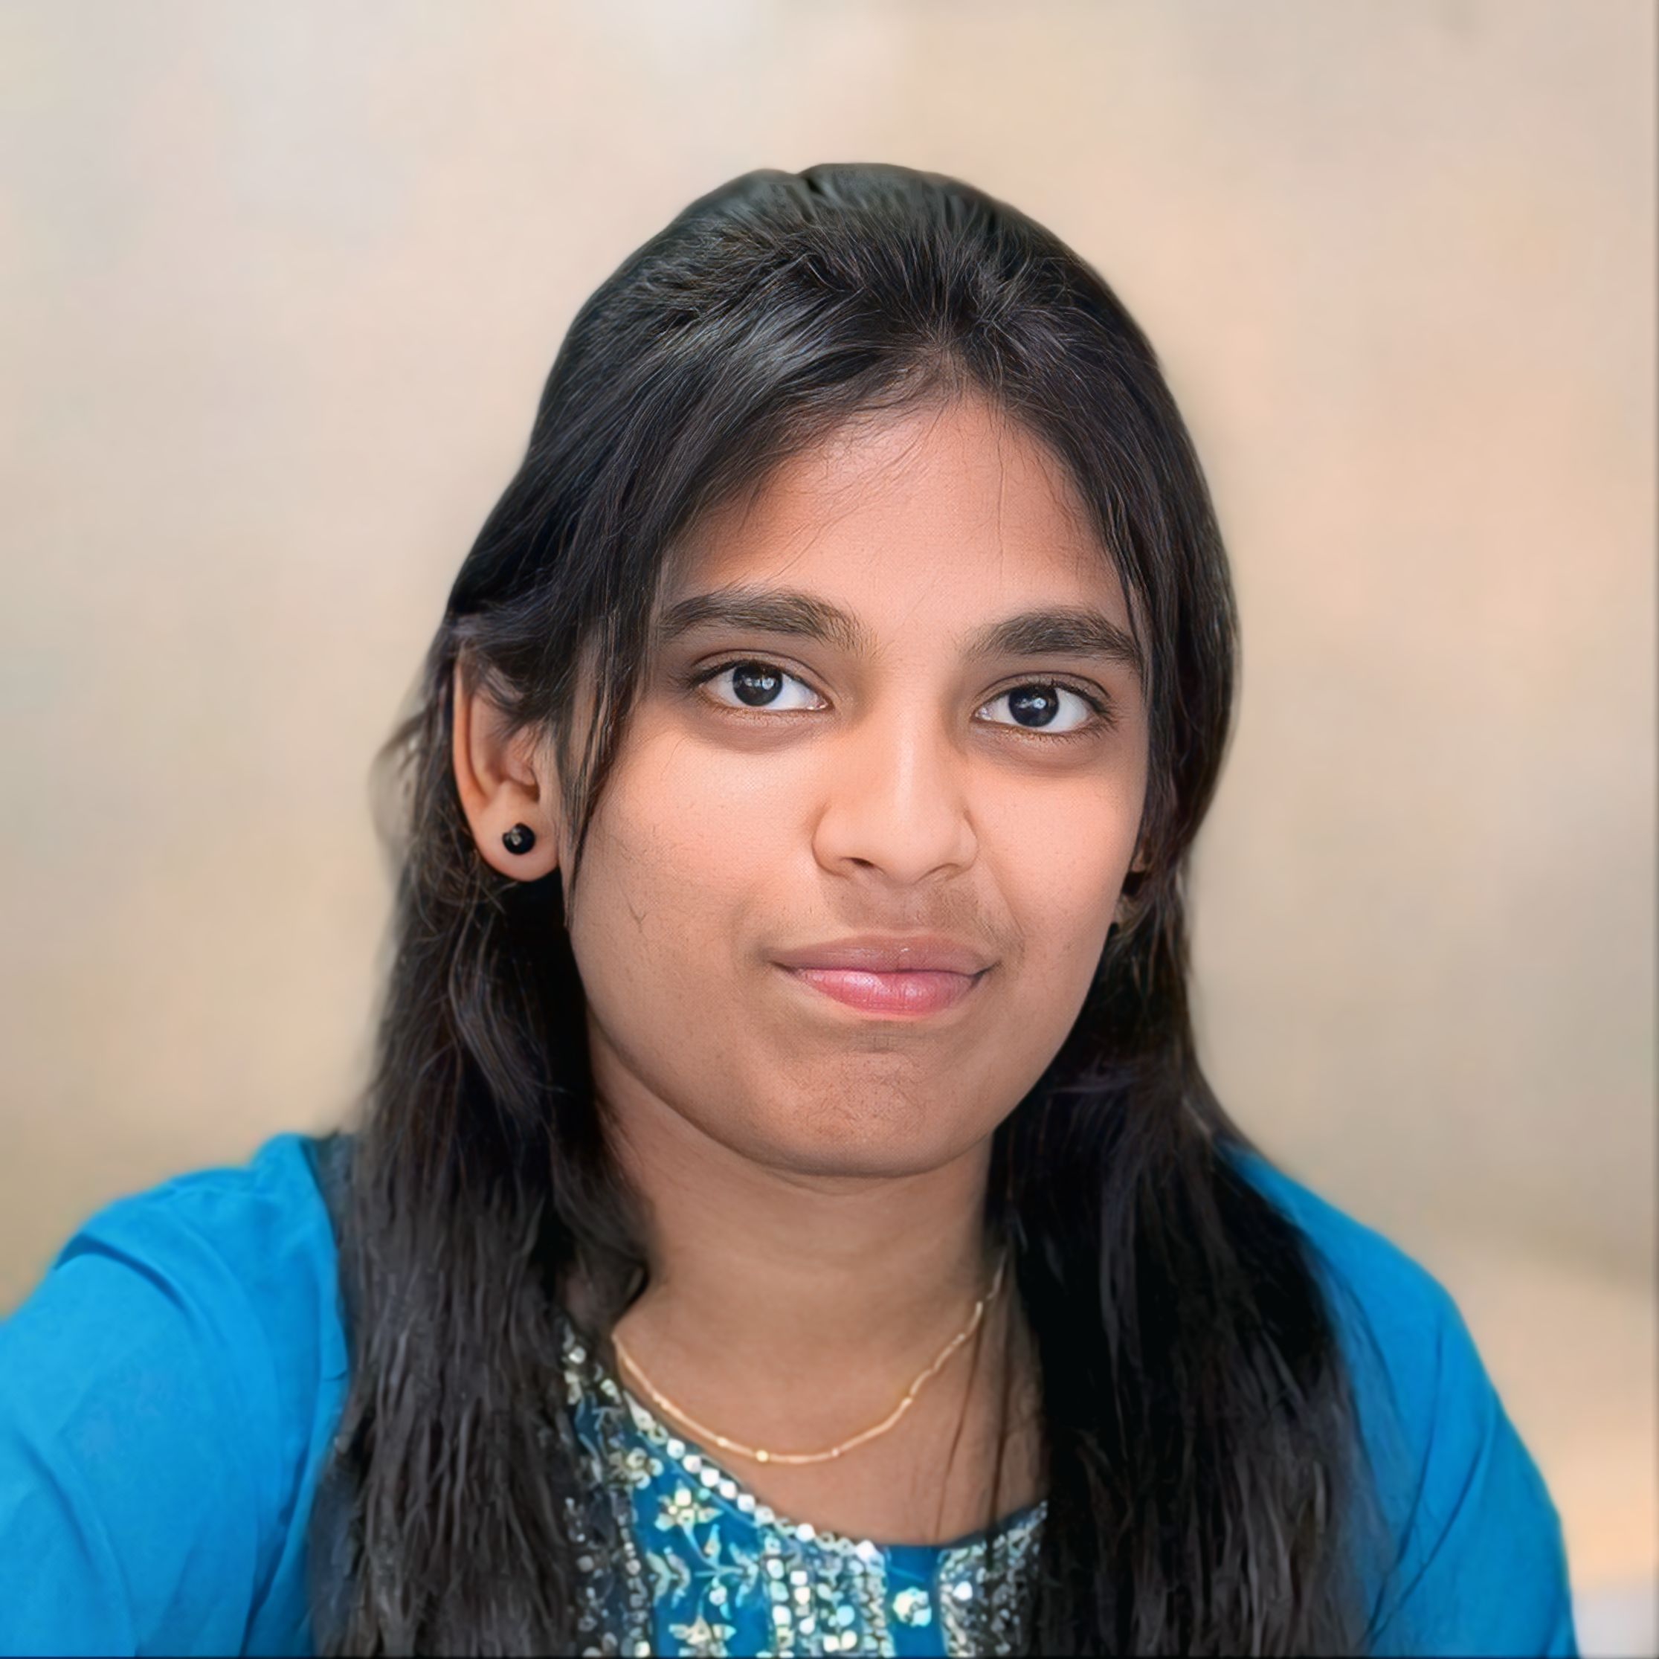
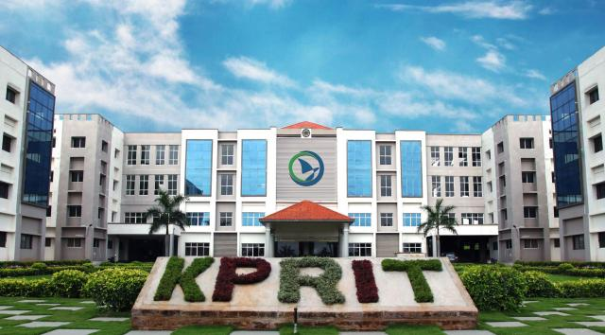
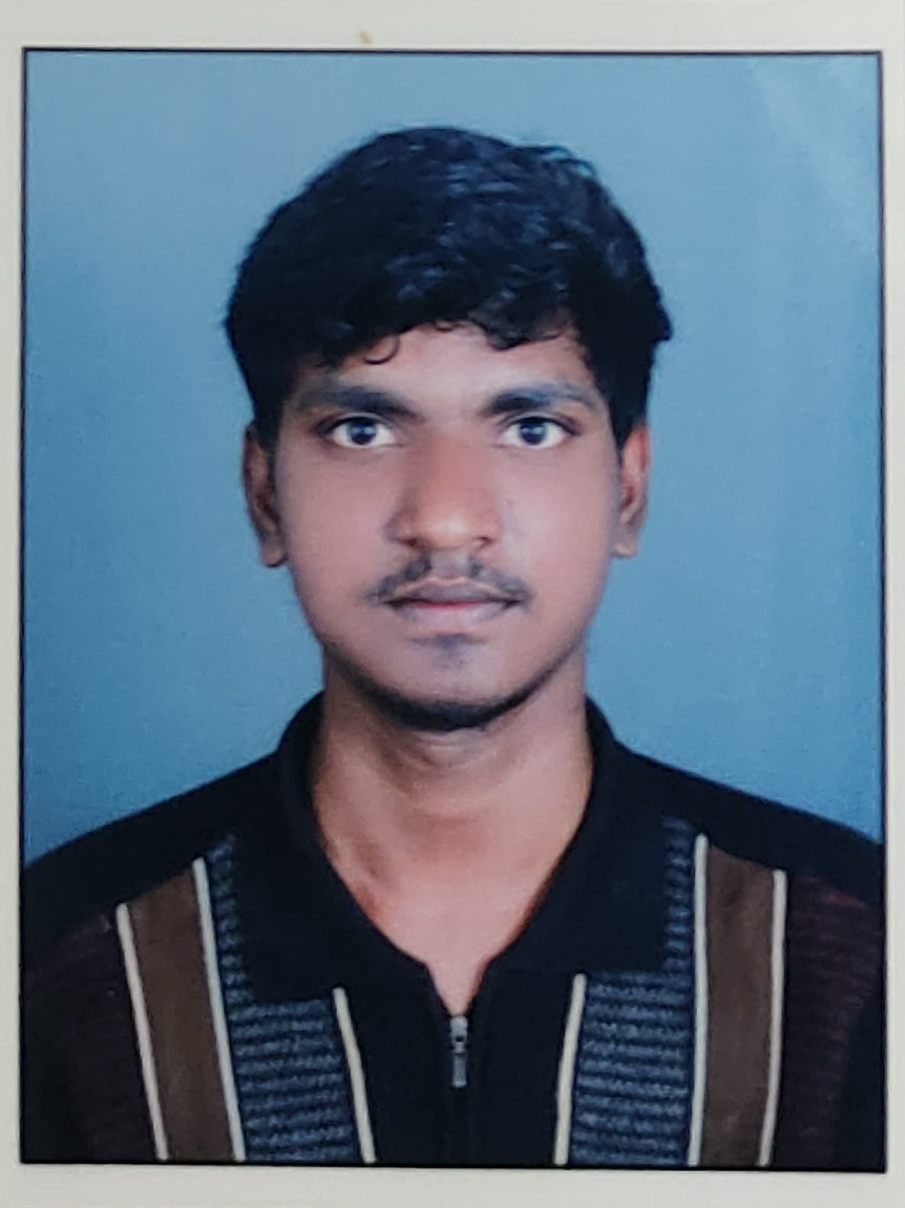
DEPARTMENT OF COMPUTER SCIENCE AND ENGINEERING
MINI PROJECT PRESENTATION
TITLE: ADVANCED IMAGE INPAINTING TECHNIQUES FOR IMPROVED SCENE ANALYSIS
PRESENTED BY
G.kalyan (22RA1A0547)
B.Ashwini (22RA1A0519)
B.Keshav (22RA1A0552)
UNDER THE GUIDANCE OF
Mrs.R.NIRANJANI
ASST. PROFESSOR, M-TECH

Slide 2

ABSTRACT
This project presents an advanced image inpainting technique using the Iterative Fast March (IFM) algorithm. Traditional methods like Nearest Neighbourhood Based Pixel Replacement (NNBPR) often fail to preserve structure and texture, especially in large missing areas. IFM addresses these limitations by filling gaps based on priority, considering both pixel confidence and image gradient. It uses patch-based replacement guided by fast marching distance maps to ensure structural continuity. The system is implemented in Python with OpenCV, and tested using PSNR, SSIM, and MSE. Results show that IFM significantly outperforms traditional methods, restoring images more naturally and accurately. This technique is highly useful in applications like medical imaging, satellite restoration, and scene reconstruction.
ADVANCED IMAGE INPAINTING TECHNIQUES FOR IMPROVED SCENE ANALYSIS

Slide 3

*Method:* Nearest Neighbourhood Based Pixel Replacement (NNBPR)*Steps:
1. Identify masked pixels
2. Search nearby unmasked pixels
3. Replace using nearest pixel value
4. Iterate for all missing pixels
EXISTING SYSTEM
DISADVANTAGE-1
1. Poor quality inpainting for large missing areas
:
NNBPR is a simple image inpainting method that fills missing pixels using the values of nearby intact pixels.
It works by identifying corrupted areas using a binary mask and locating their nearest known neighbors.
The missing pixels are replaced by averaging or copying the values of these neighbors.
This method is fast and easy to implement but struggles with large or complex missing regions.
DISADVANTAGE-2
2. Blurred edges and texture loss

Slide 4

PROPOSED
SYSTEM
Technique: Iterative Fast March Inpainting (IFM)*Steps: Uses fast-marching distance transform
Computes boundary priorities
Iteratively fills missing regions using best-matching patches
Produces natural, structure-aware inpainting
ADVANTAGE-1
Handles complex, large missing
regions.
:
IFM uses a fast marching distance transform to guide how missing areas are filled, prioritizing boundary pixels.
It selects the best-matching patches from undamaged regions to fill the missing areas, preserving structure.
The process is iterative, gradually refining the inpainting result with each step.
IFM maintains the texture and edges of the image more accurately than traditional methods.
ADVANTAGE-2
2. Produces high-fidelity, realistic results:

Slide 5

SYSTEM REQUIREMENTS
SOFTWARE
HARDWARE
12th Gen Intel(R) Core(TM) i5-1235U, 1300 Mhz, 10 Core(s), 12 Logical Processor(s)
8 GB RAM
512 GB storage
Python 3.7.6
OpenCV,
NumPy,
Matplotlib,
Scikit-image

Slide 6
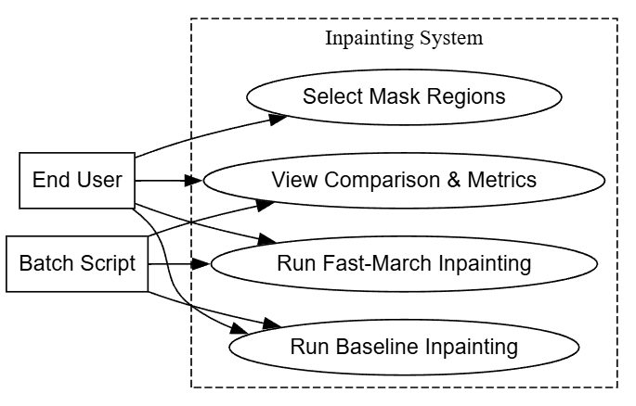

UML DIAGRAM
USE CASE DIAGRAM

Slide 7
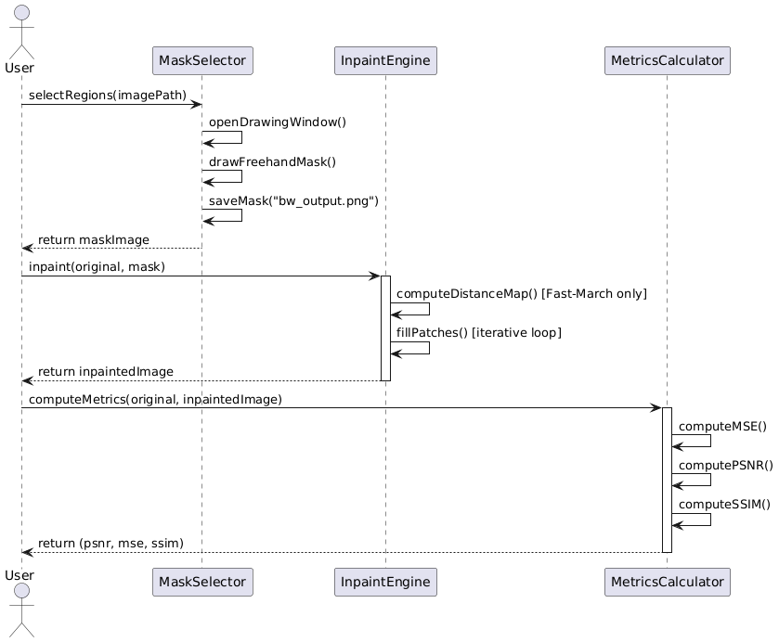
UML DIAGRAM
SEQUENCE DIAGRAM

Slide 8

MODULES
Interactive Mask Drawing
Nearest Neighbor Inpainting
Fast March Inpainting
Metrics Computation
Exploring creativity

Slide 9
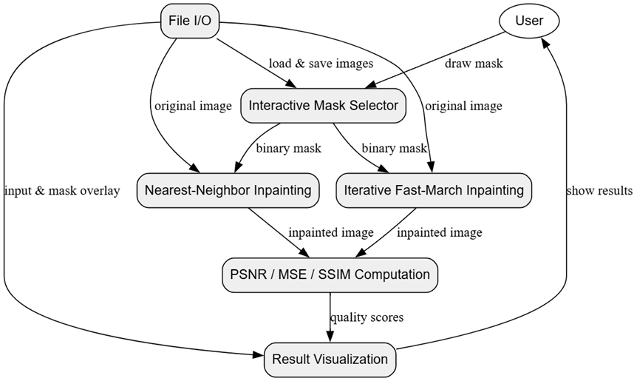
MAIN ROLES
SYSTEM ARCHITECTURE
1. User
2. Baseline Engine
3. Fast March Engine
4. Metrics Module
Proposed system architecture.

Slide 10

Iterative Fast March Algorithm
ALGORITHM
It fills missing regions by prioritizing boundary pixels based on image confidence and data (gradient).
It uses a patch-based approach where missing areas are filled with the best-matching content from known regions.
Algorithm Steps :
Load the image and mask
Compute priorities for boundary pixels
Choose the highest-priority patch
Find the best-matching patch from known areas
Copy pixel data to the missing region
Update the mask and recompute priorities
Repeat until the image is fully restored

Slide 11
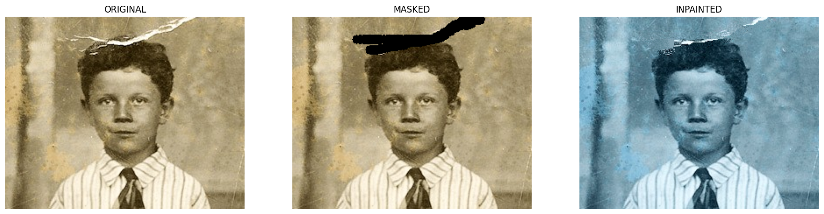
EXISTING SYSTEM input and output:
Existing Method: PSNR, Value: 4.13 dB
MSE, Value: 25103.80
SSIM, Value: 0.0032

Slide 12
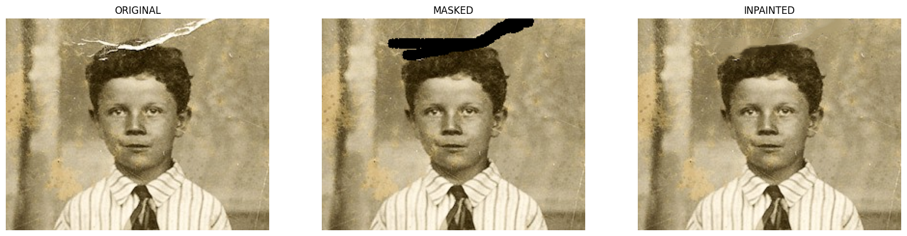
PROPOSED SYSTEM input and output
Proposed Method: PSNR, Value: 29.75 dB
MSE, Value: 68.90
SSIM, Value: 0.8898

Slide 13

CONCLUSION
Proposed method drastically improves image quality over traditional methods.
Metrics:
Existing: PSNR 4.13,SSIM 0.0032,MSE 25103.80
Proposed: PSNR 29.75, SSIM 0.8898,MSE 68.90
Ideal for applications in medical imaging, satellite processing, AR/VR, and digital restoration.
ADVANCED IMAGE INPAINTING
TECHNIQUES FOR IMPROVED
SCENE ANALYSIS

Slide 14

Thank you very much!

